Slide 1
Graph-Based Screening for Potentially Cooperative Vessel Pairs
A temporal link prediction approach using AIS (2012–2019)

Slide 2
Agenda
Problem & motivation
Pipeline overview
Graph construction
Deep dive: the TGCN model
Results & validation
Gear-aware stratification
Case studies
Limitations & conclusion
Notes:
Walk through the agenda quickly — emphasize that the professor asked for a deep dive on the TGCN, which is section 4. Total talk is 20 minutes.

Slide 3
Problem & Motivation

Slide 4
Why This Matters
IUU fishing costs $10–23 B/year globally
Enforcement needs tools to flag coordinated vessel behavior
AIS gives billions of position records — but cooperation is never labeled
No ground truth → supervised learning is not possible
Our approach: unsupervised screening pipeline — ranked candidate list for human review, not a verdict
Notes:
IUU = illegal, unreported, unregulated fishing. AIS = Automatic Identification System — vessels broadcast position, speed, heading. The key constraint is that nobody has labeled which vessel pairs are “cooperating” — so we can’t train a classifier. Instead we treat it as temporal link prediction: if two vessels keep appearing near each other across time, the model gives them a high score.

Slide 5
What This Work Does — and Does Not Do
Does | Does not
Temporal link prediction on daily graphs | Prove coordination or IUU
Ranked candidate list with scores | Replace human analysis
Independent geographic validation | Claim outputs are ground truth
Gear-aware characterization of excluded pairs
Notes:
This slide manages expectations up front. The committee should understand that high model scores mean “plausible future co-occurrence” — not guilt. The output is a list for analysts to review, plus reproducible checks.

Slide 6
Pipeline Overview

Slide 7
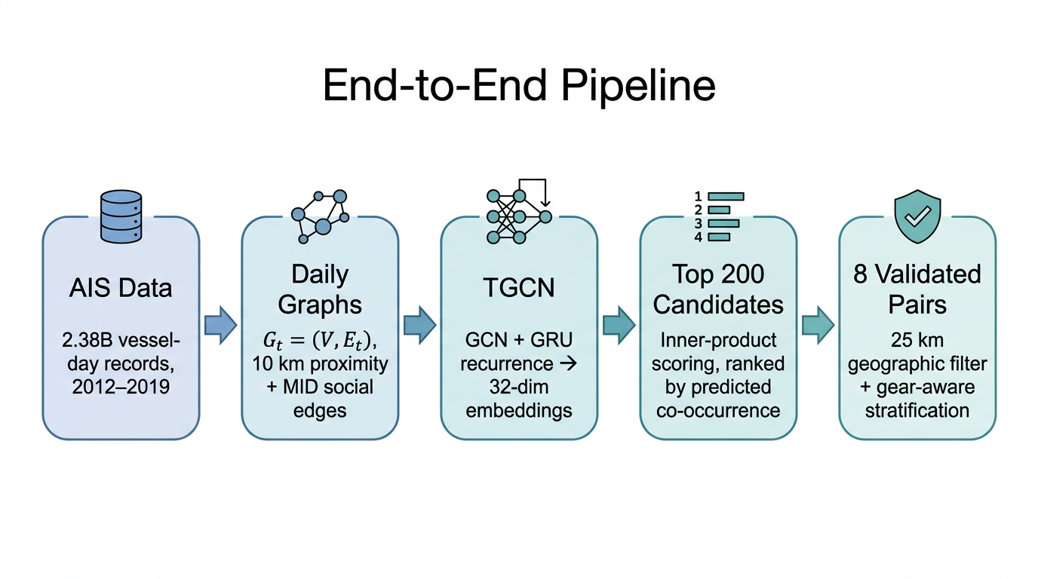
End-to-End Pipeline
Pipeline
Notes:
Walk through left to right: (1) We start with 2.38 billion vessel-day AIS records across 2012–2019. (2) Each calendar day becomes a snapshot graph — vessels are nodes, edges connect vessels within 10 km on the same day, plus optional social edges from shared national registry prefix. (3) The TGCN processes this sequence of daily graphs, producing 32-dimensional embeddings per vessel. (4) We score all vessel pairs by inner product of their embeddings — top 200 are candidates. (5) A strict 25 km geographic filter on raw tracks winnows to 8 validated pairs, and gear-aware stratification explains why the other 192 were excluded.

Slide 8
Graph Construction

Slide 9
How We Build Daily Graphs
 | Distance | Purpose
Training | ≤ 10 km, same day | Defines graph edges
Validation | 25 km, ±1 day | Post-hoc check on raw tracks
Proximity edges (training signal):
Same calendar day, Haversine distance ≤ 10 km between daily mean positions
This defines $E_{t}$ — the only distance used for training
Social edges (optional augmentation):
Same 3-digit ITU MID prefix (e.g., 412 = China)
Capped at 2,000 per day to keep graphs tractable
Critical distinction:
Notes:
The most important thing for the committee to understand: training edges and validation distances are NEVER mixed. The model learns from 10 km same-day proximity. The 25 km check is applied AFTER training to validate candidates on raw AIS tracks — it’s a completely independent filter. Stress this — it’s what makes the validation credible.

Slide 10
Deep Dive: The TGCN Model

Slide 11
What Is a TGCN?
Combines two ideas:
GCN — learns from who is near whom on a single day
GRU — learns how that structure changes across days
Key insight: Replace the GRU’s linear layers with graph convolutions → the recurrence is graph-aware
Each vessel’s hidden state is updated based on its neighbors in that day’s graph
Notes:
A Temporal Graph Convolutional Network. The standard GRU processes sequences of vectors. The TGCN processes sequences of GRAPHS. Inside each GRU gate, instead of a matrix multiply, there’s a graph convolution — so the model aggregates information from a vessel’s neighbors before deciding how to update its hidden state. We use the TGCN class from PyTorch Geometric Temporal by Rozemberczki et al.

Slide 12
How GCNConv Works
For each vessel $u$, aggregate neighbor features:
hu′=σ​v∈N(u)∪{u}​1du⋅dv W hv
In plain English:
Look at all vessels within 10 km today
Weighted average of their features (inverse degree normalization)
Multiply by learnable weights $W$
Result: each embedding encodes the local neighborhood structure
Notes:
This is the Kipf & Welling 2017 GCNConv. The normalization factor 1/sqrt(d_u * d_v) ensures high-degree nodes don’t dominate — a vessel in a crowded fishing ground doesn’t overwhelm the embedding just because it has many neighbors. The weight matrix W is learned during training. After one GCN layer, vessel u’s embedding reflects not just its own features but who it’s near. With multiple layers (or the recurrence), information propagates further through the graph.

Slide 13
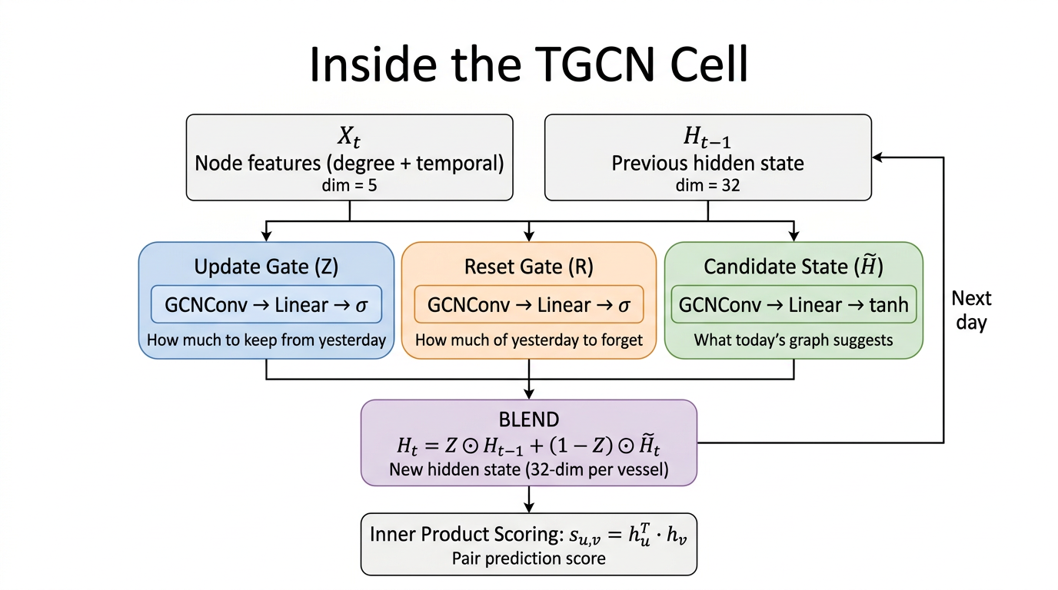
Inside the TGCN Cell
TGCN Architecture
Notes:
Walk through the diagram top to bottom. INPUTS: X_t is the node feature matrix for today (dimension 5 per vessel — degree plus 4 temporal features). H_{t-1} is the hidden state carried from yesterday (32 dimensions per vessel). THREE GATES, each using GCNConv: (1) Update gate Z — sigmoid output between 0 and 1 — decides how much of yesterday’s hidden state to keep. (2) Reset gate R — also sigmoid — decides how much of yesterday to forget before computing the new candidate. (3) Candidate state H-tilde — uses tanh — what today’s graph says the hidden state should be, with yesterday partially reset. BLEND: The final hidden state H_t is a weighted mix: Z times yesterday plus (1-Z) times the candidate. If Z is close to 1, the model keeps yesterday’s state (vessel behavior hasn’t changed). If Z is close to 0, the model overwrites with today’s graph information. The “Next day” arrow shows this H_t becomes H_{t-1} for tomorrow — that’s the recurrence.

Slide 14
The Three Gates — Equations
Update gate — how much to keep from yesterday:
$$Z_{t}=σ\left(\text{Linear}[\text{GCNConv}(X_{t})∥H_{t−1}]\right)$$
Reset gate — how much of yesterday to forget:
$$R_{t}=σ\left(\text{Linear}[\text{GCNConv}(X_{t})∥H_{t−1}]\right)$$
Candidate state — what today’s graph suggests:
$${\tilde{H}}_{t}=tanh\left(\text{Linear}[\text{GCNConv}(X_{t})∥R_{t}⊙H_{t−1}]\right)$$
Final hidden state — blend:
$$H_{t}=Z_{t}⊙H_{t−1}+(1−Z_{t})⊙{\tilde{H}}_{t}$$
Notes:
This is the same diagram in equation form — reference the diagram as you walk through it. Each gate takes today’s features through a GCNConv (so it’s graph-aware), concatenates with yesterday’s hidden state, then applies a linear layer and activation. Sigmoid for the gates (output between 0 and 1 — “how much”). Tanh for the candidate (output between -1 and 1 — “what direction”). The element-wise multiply (circle-dot) means each dimension of the 32-dim embedding is gated independently. The key intuition: if a vessel’s neighborhood hasn’t changed much, Z stays high and the hidden state carries forward. If the neighborhood changes dramatically (new co-occurrences), Z drops and the model incorporates today’s graph.

Slide 15
Node Features (Input to the TGCN)
5 features per vessel per day (all z-score standardized):
Degree (daily) — neighbors within 10 km today
Interaction count (static) — total edges across training
Unique partners (static) — distinct co-occurring vessels
Last seen (static) — days since last appearance
Mean gap (static) — average interval between appearances
Notes:
These features tell the model about each vessel’s behavioral profile. Degree captures today’s activity level — it changes every day. The four static features are computed once from training history and capture long-term patterns: a vessel with high interaction count and many unique partners behaves very differently from one with few, sporadic contacts. Last-seen and mean-gap capture temporal regularity. All features are z-score standardized (mean 0, std 1) so no single feature dominates. The combined input is 5-dimensional per vessel per day.

Slide 16
Scoring: Embeddings → Pair Predictions
After processing day $t$, each vessel $u$ has embedding $h_{u}∈R^{32}$
Pair score (inner product):
$$s_{u,v}=h_{u}^{⊤}h_{v}=\sum_{i=1}^{32}{h_{u,i}}⋅h_{v,i}$$
High score → similar neighborhood patterns across time → predicted co-occurrence
Low score → no structural reason to expect co-occurrence
Why inner product? Simplest similarity measure — if embeddings point in the same direction, the dot product is large
Notes:
This is where the model makes predictions. After the TGCN processes a day’s graph, every vessel has a 32-dimensional embedding vector. To score a pair, we just take the dot product — it’s fast and interpretable. Two vessels with similar embeddings (similar neighborhoods, similar temporal patterns) get a high score. The score is a logit — it goes through BCEWithLogitsLoss during training, but at inference we just rank pairs by raw score. The top 200 pairs by score become our candidates.

Slide 17
Training Loop
For each of 3 epochs, iterate through 1,450 days in chronological order:
Build today’s graph $G_{t}$
Forward pass: $H_{t}=\text{TGCN}(X_{t},G_{t},H_{t−1})$
Score positive pairs (actual edges) and negative pairs (random non-edges, count-matched)
Loss: BCEWithLogitsLoss — positives should score high, negatives low
Backprop + Adam update (LR = 0.001)
Detach $H_{t}$ — truncated BPTT (laptop memory constraint)
No cooperation labels — only structural positives vs random negatives
Notes:
The training loop processes days in order — this is crucial because the hidden state carries temporal information forward. For each day, we have positive pairs (the actual edges in E_t, meaning vessels within 10 km) and we sample the same number of random non-edges as negatives. BCEWithLogitsLoss trains the model to rank positives above negatives. The key implementation detail is truncated backpropagation through time: after each day, we detach the hidden state from the computation graph. This means gradients only flow through one day at a time, not through the full 1,450-day sequence. We had to do this because the laptop has 16 GB RAM — without detaching, the computation graph would grow until memory runs out. The trade-off is that the model can’t learn very long-range dependencies, but in practice the daily recurrence still captures meaningful temporal patterns.

Slide 18
Evaluation: What the Metrics Mean
Chronological split: train on days 1–1,450 / test on days 1,451–2,326
ROC AUC = 0.73: If you pick a random real edge and a random non-edge, there’s a 73% chance the model ranks the real edge higher
AP = 0.71: The precision-recall curve has area 0.71 — reasonable precision as recall increases
Per-bucket variability: std ±0.10 across 876 test days — some days are easier (dense graphs), others harder (sparse)
Notes:
The chronological split is important — we’re not doing random train/test splitting, which would leak future information. The model trains on earlier days and is evaluated on later days, so the metrics measure genuine forecasting ability. 0.73 AUC is moderate — it means the model is meaningfully better than random (0.50) but far from perfect. This is expected for an unsupervised approach on a hard problem with no labels. The per-bucket standard deviation of 0.10 means some individual days score much higher or lower — the 0.73 is a macro-average. If the committee asks “is 0.73 good enough?” — the answer is that the model’s purpose is screening, not classification. Even moderate ranking ability can surface useful candidates when paired with post-hoc validation.

Slide 19
Results & Validation

Slide 20
Quantitative Performance (Table 1)
Setting | ROC AUC | AP
Combined + social (primary) | 0.730 | 0.714
Proximity-only (ablation) | 0.776 | 0.795
Capped graph (sanity check) | ~0.95 | ~0.96
Notes:
Three rows, three different experiments — don’t mix metrics across them. The combined graph (our primary result) adds social edges from shared national registry prefix. Counter-intuitively, this lowers AUC compared to proximity-only. If the committee asks why: MID 412 (China) connects thousands of vessels into a massive clique — most never physically meet. Three effects: (1) Noise — registry edges that don’t correspond to co-occurrence. (2) Over-smoothing — dense neighborhoods blur embeddings. (3) Objective dilution — BCE loss treats social edges identically to proximity edges. The capped graph is a much easier task — don’t compare those numbers to the primary result. Future work: heterogeneous-edge architectures that weight edge types differently.

Slide 21
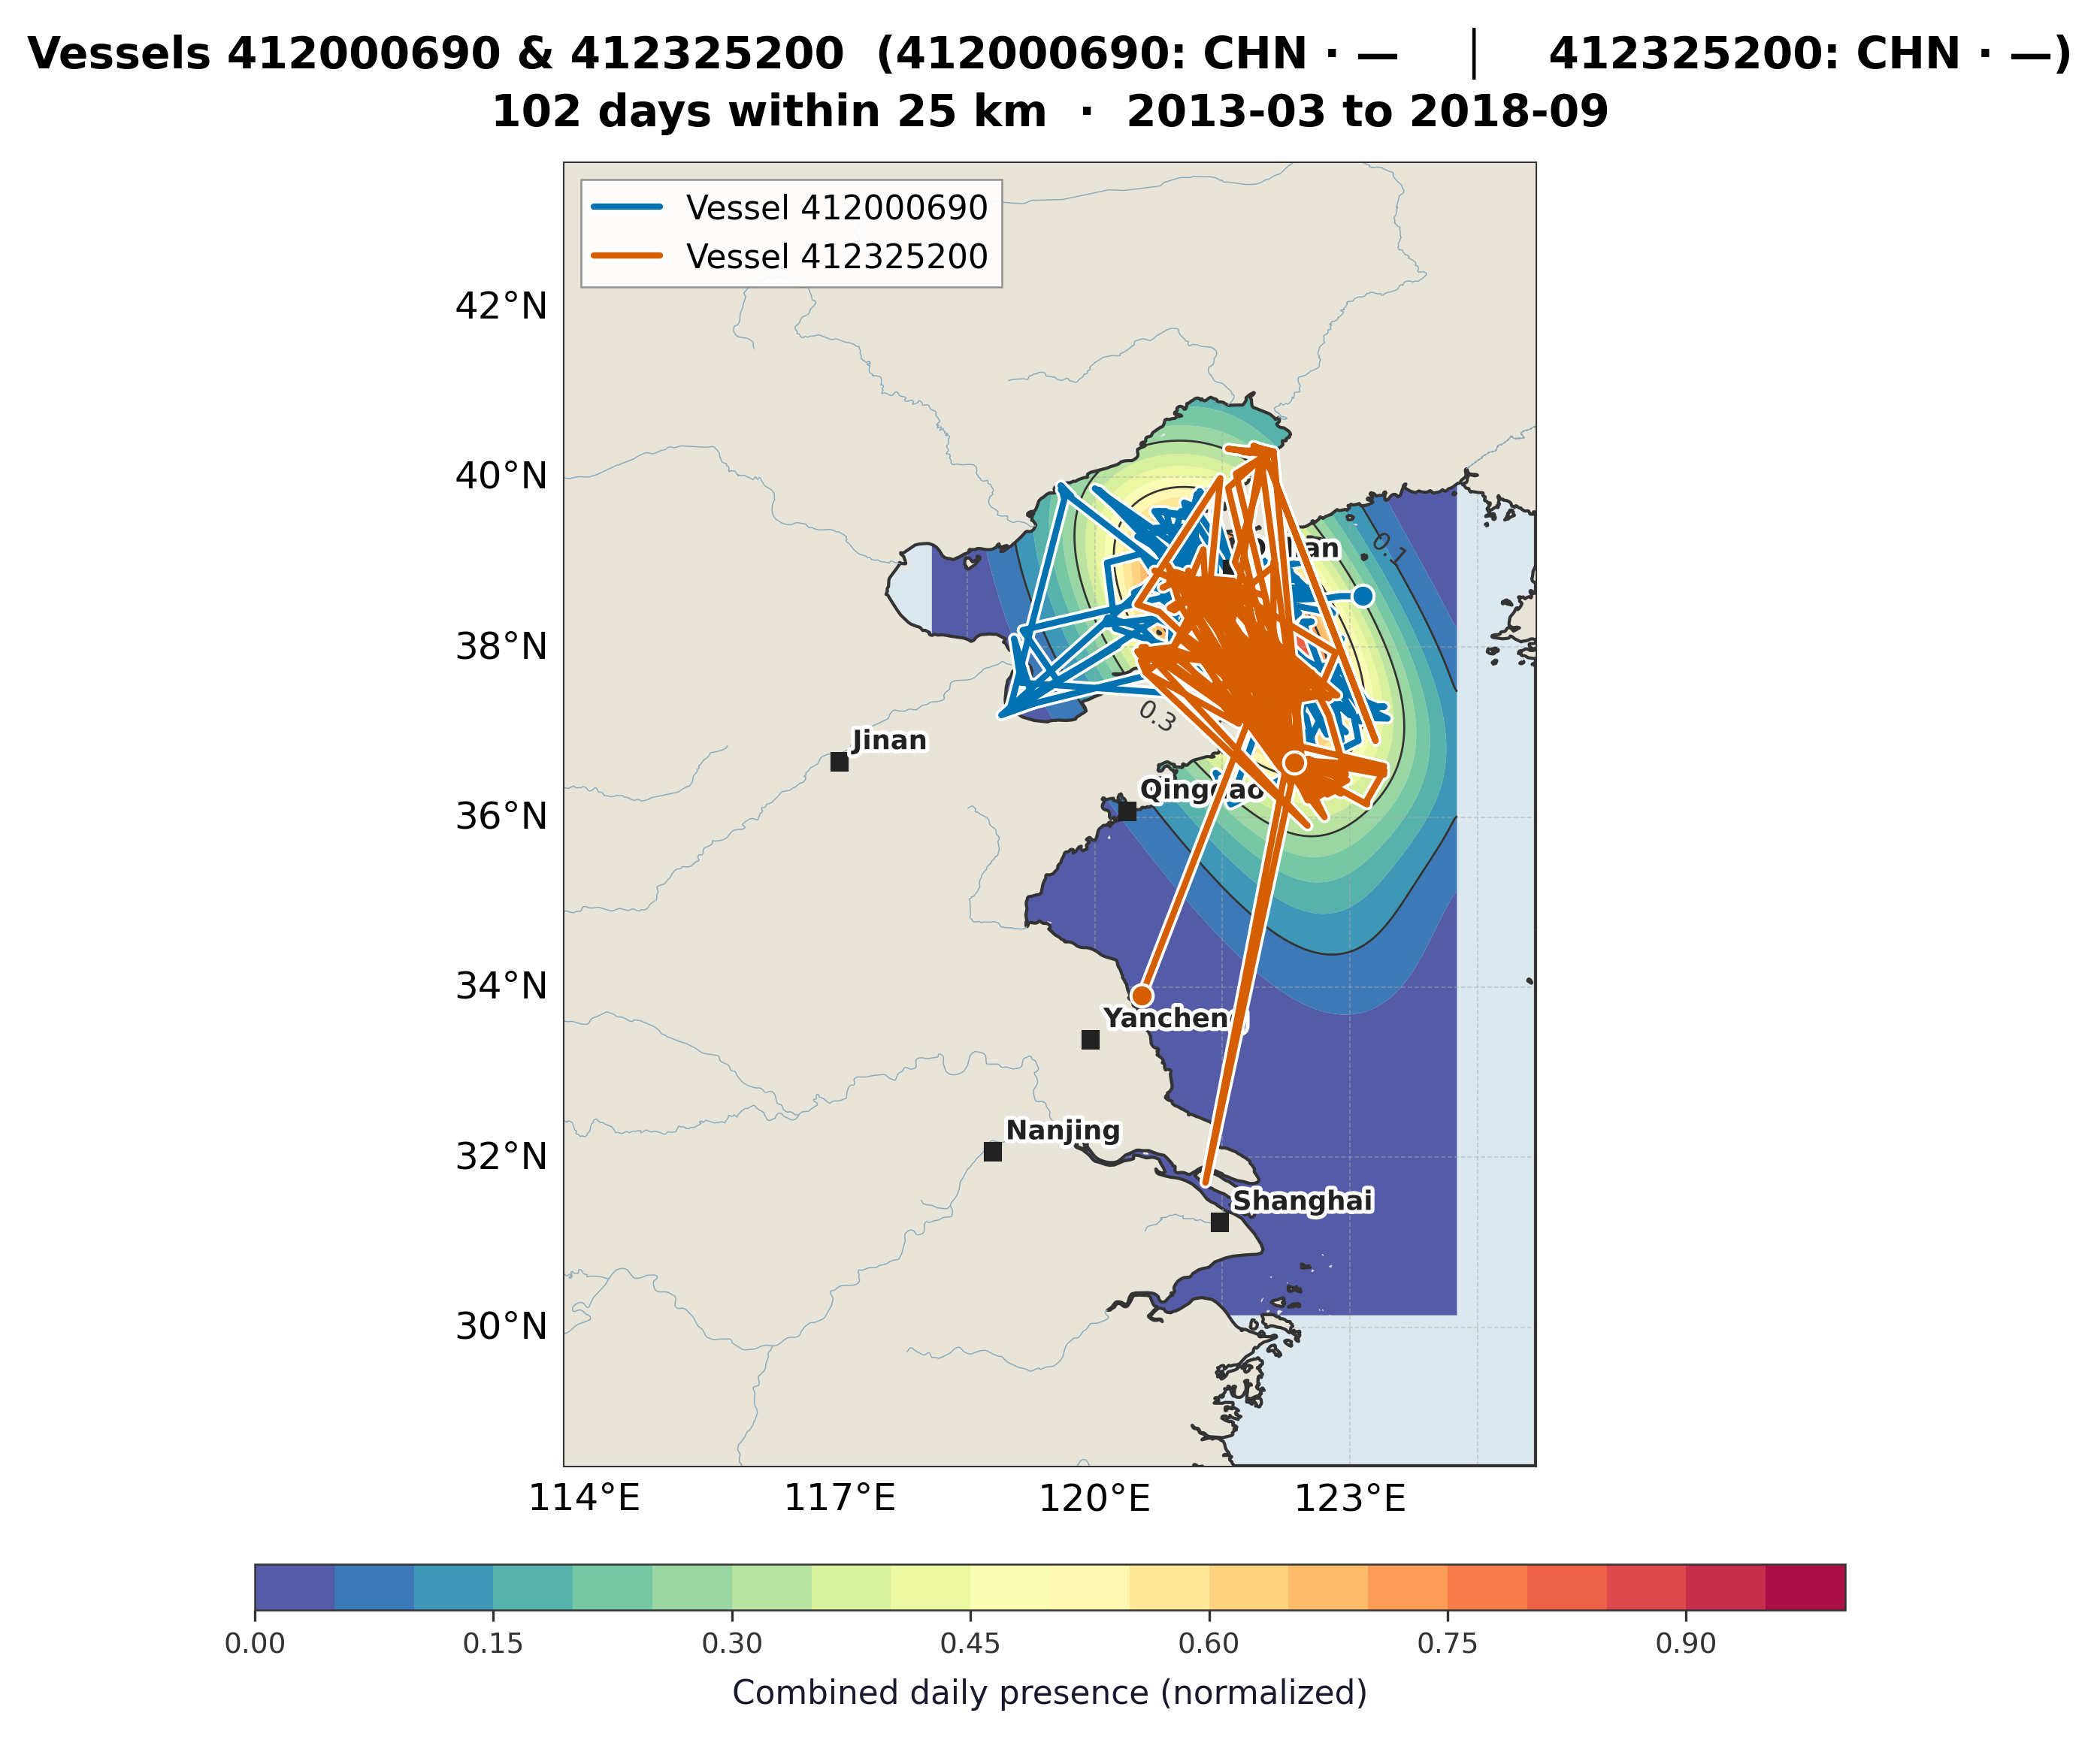
Geographic Validation: 8 of 200 Survive
Figure 1 — Flagship pair
Notes:
Of the top 200 TGCN candidates, we applied a strict 25 km, plus-or-minus 1 day proximity filter on raw daily AIS tracks. Only 8 pairs survive. This figure shows the flagship pair — 412000690 and 412325200 — with 102 days within 25 km. Blue traces are one vessel, orange traces the other. The background heatmap shows combined daily presence density — warmer colors mean both vessels were frequently in that area. The hot spot in the Yellow Sea around 121 East, 37-39 North confirms the model’s abstract high score corresponds to real, sustained co-presence. If the model were surfacing random pairs, we would not expect their tracks to overlap like this.

Slide 22
Gear-Aware Stratification

Slide 23
Why Did 192 of 200 Candidates Fail?
Three-step analysis:
Step 1 — Gear enrichment: 267 MMSIs → dominant gear type from 96 sampled fleet days (2012–2019)
Step 2 — Co-location baseline: 32 fleet days → ~7M cell-days → how often each gear pair shares a cell by default
Step 3 — Gear-adjusted score:
$$S_{\text{adj}}=S_{\text{orig}}×\frac{1}{1+2⋅\hat{B}}$$
High fleet co-location → larger discount; cross-gear pairs → less affected
Notes:
This is the post-hoc analysis that explains WHY only 8 survived. Step 1: we enrich each vessel with its dominant gear type by joining MMSI daily positions to cell-aggregated fleet data — 96 sampled days across 2012-2019 gives broad coverage. Step 2: separately, we compute a baseline of how often each gear combination shares the same grid cell in the fleet data — about 7 million cell-days. This tells us what’s “normal.” Step 3: we discount each candidate’s TGCN score by their gear pair’s baseline rate. The formula uses alpha=2 as the discount strength. Trawler-trawler pairs have high baselines (they’re everywhere together), so they get a big discount. Cross-gear pairs like fixed gear plus trawlers have low baselines — their scores are barely affected.

Slide 24
The 10× Story
75% of top 200 are trawler-dominated — they fish the same waters by default
Pass rates tell the real story:
Fixed gear + Trawlers: 25% (1 of 4 pairs pass)
Set gillnets + Trawlers: 8.3% (1 of 12)
Line / generic + Trawlers: 6.0% (4 of 67)
Trawlers + Trawlers: 2.4% (2 of 82)
10× difference between cross-gear and same-gear pass rates
Notes:
This is the key finding. Trawlers dominate the candidate list for a simple reason: they’re the most common vessel type, they concentrate in the same fishing grounds, and two trawlers following the same seasonal fish migration look structurally identical to the TGCN. 80 of 82 trawler-trawler pairs fail the 25 km check — their graph similarity doesn’t translate to sustained physical proximity on a given day. Cross-gear pairs are the opposite. A fixed-gear vessel (stationary nets or traps) and a trawler (mobile) rarely share the same grid cell by chance. When the model flags such a pair AND the geographic filter confirms repeated 25 km proximity, that co-location is unlikely to be coincidental. That’s why fixed gear + trawlers passes at 25% — ten times the trawler-trawler rate.

Slide 25
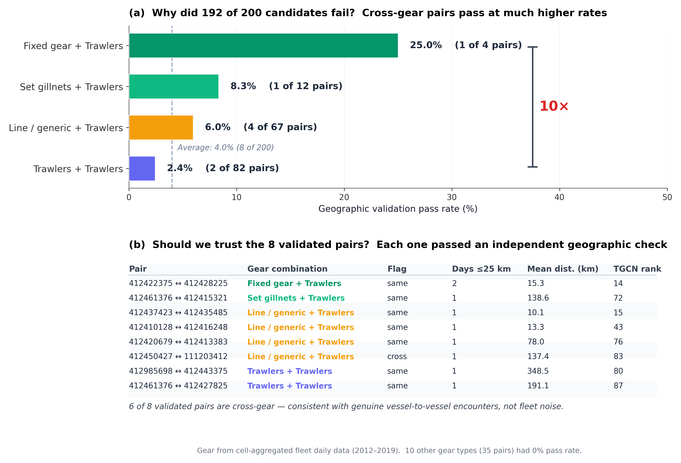
Figure 2: Pass Rates + The 8 Validated Pairs
Figure 2
Notes:
Panel (a) shows the pass rate bars. The dashed line is the overall average at 4%. Cross-gear categories are all above average; trawler-trawler is below. The bracket highlights the 10x difference. Panel (b) is the table of the 8 validated pairs — MMSI identifiers, gear combination, whether they share a flag, days within 25 km, mean distance, and TGCN rank. Notice that 6 of 8 are cross-gear pairs. The two trawler-trawler pairs have higher mean distances (191 and 349 km) and lower ranks — they’re the weakest of the 8. The Set gillnets + Trawlers pair jumped 48 ranks after gear adjustment (72 to 24) — originally buried among trawler pairs, revealed as one of the most distinctive candidates.

Slide 26
What This Means
Two takeaways:
The geographic filter is justified — 192 excluded pairs reflect normal fleet behavior, not model failure
The 8 validated pairs are strengthened — cross-gear pairs survive at disproportionate rates → enriched for behaviorally unusual encounters
Notes:
The gear-aware analysis serves as the justification layer. The 192 excluded pairs aren’t false positives in the traditional sense — the model genuinely detected shared movement patterns. But those patterns are explained by thousands of same-type vessels fishing the same waters. The filter correctly separates fleet-level noise from pair-specific signal. The fact that cross-gear pairs survive at 10x the rate means our validated set is enriched for the exact kind of encounter that warrants investigation — two vessels with different operating modes repeatedly appearing in close proximity.

Slide 27
Case Studies

Slide 28
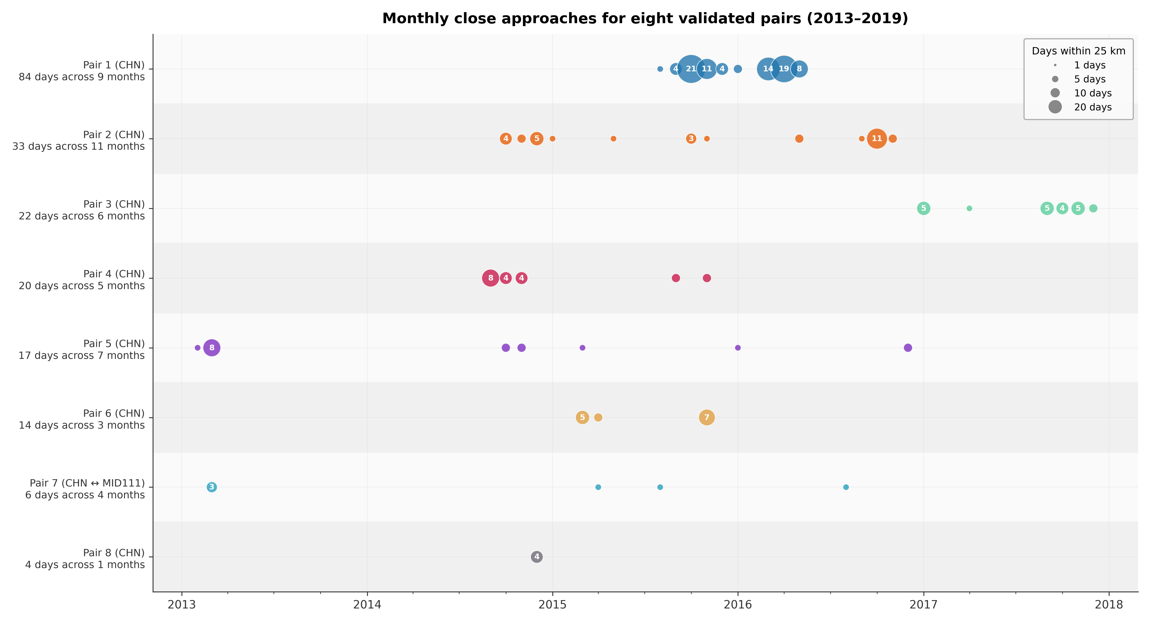
Monthly Overlap (Figure 3)
Pair 1: 84 days across 9 months — persistent co-presence (2015–2016)
Most others: sporadic — occasional, not sustained
Pair 7: only cross-flag pair (CHN ↔ MID111)
Figure 3
Notes:
Each row is one validated pair, sorted by total overlap days. Bubble size is proportional to days within 25 km that month. Pair 1 dominates — large bubbles clustered in 2015-2016, showing persistent co-presence over an extended period. Most other pairs are sporadic — a handful of small bubbles scattered across years, suggesting occasional rather than sustained proximity. Pair 7 is the only one involving a non-Chinese vessel (MID111). The pattern differences matter: persistent co-presence (Pair 1) is more suggestive of coordination than occasional encounters.

Slide 29
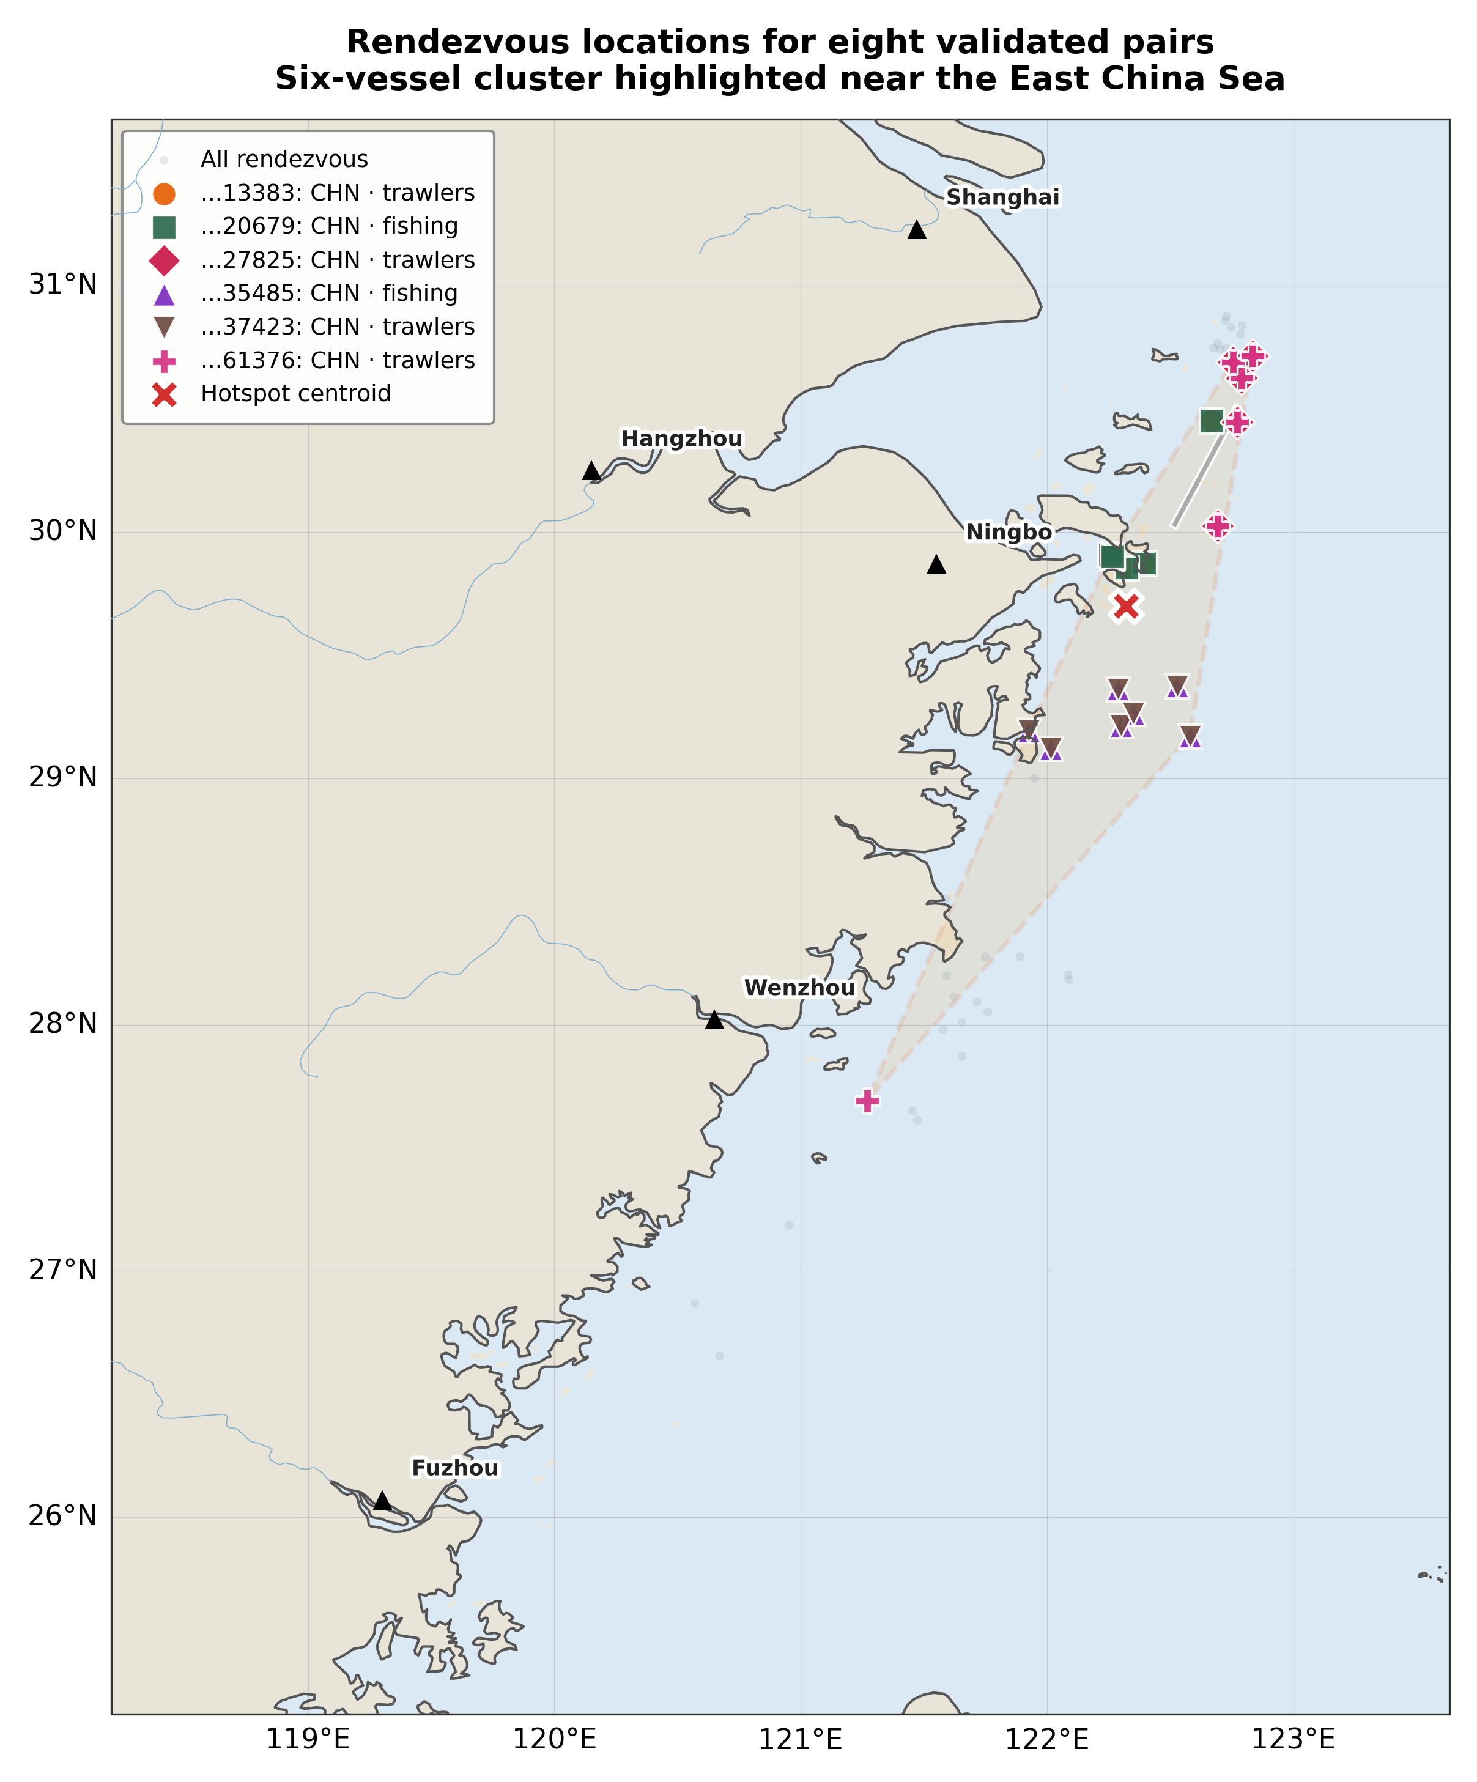
Six-Vessel Cluster (Figure 4)
Six vessels from multiple distinct pairs converge on the same area east of Ningbo
Concentrated between 29°N–30.5°N, ~122°E
Consistent with a shared operating region
Figure 4
Notes:
This figure plots rendezvous locations for all eight validated pairs against the Chinese coast. The colored markers highlight six specific vessels that appear in multiple pairs — they form a cluster. The red X marks the weighted centroid at roughly 29.7 North, 122.3 East — about 50-80 km offshore from Ningbo in the East China Sea. The fact that vessels from different pairs converge on the same narrow band suggests a shared operating region rather than coincidence. This is consistent with the co-presence patterns in Figure 3.

Slide 30
Limitations & Conclusion

Slide 31
Limitations
Link prediction ≠ verdict — high scores can reflect shared fishing grounds, ports, traffic lanes
AIS gaps — vessels may disable AIS or have sparse coverage
Confounding by density — crowded regions produce many possible edges
Single-seed headline — per-bucket std ±0.10; multi-seed runs are future work
Gear labels are coarse — fleet-level categories, not formal licenses
Gear-adjusted score is a heuristic — different discount functions would shift exact ranks
Notes:
Be upfront about these. The most important one: link prediction is not a verdict. High scores mean “plausible future co-occurrence under the graph definition” — not guilt. AIS compliance is another real issue — vessels can turn off their transponders, so we only see what’s reported. The single-seed limitation is honest — we report per-bucket dispersion and cross-seed results on the capped graph, but full multi-seed CIs on the headline number await higher-memory hardware.

Slide 32
Conclusion
What we built:
Unsupervised AIS → graph → TGCN pipeline with time-split evaluation
0.73 ROC AUC, 0.71 AP on 876 test days
8 pairs survive strict 25 km post-hoc screening
Gear-aware stratification: 75% of candidates are fleet noise; validated cross-gear pairs are 10× more likely to survive
The output: a ranked candidate list + reproducible checks — not a determination of wrongdoing
Notes:
Summarize crisply. Emphasize: unsupervised (no labels), time-split (no leakage), reproducible (all code and commands in Appendix B). The gear-aware stratification is the analytical contribution that ties the whole story together — it explains WHY the filter works, not just THAT it works.

Slide 33
Future Work
Multi-seed runs on high-memory hardware
Heterogeneous-edge architectures for social edges (weight proximity ≠ registry)
Finer spatial/temporal resolution
Owner or fleet metadata from registries
Movement-based gear classifiers integrated into the pipeline
Notes:
If the committee asks what you’d do with more time: multi-seed is the obvious next step to get confidence intervals on the headline number. Heterogeneous edges would address the social-edge AUC drop by letting the model treat proximity and registry edges differently. Finer resolution and registry metadata would improve both the model inputs and the post-hoc validation.

Slide 34
Thank You — Questions?
Key takeaway: The TGCN surfaces candidates from graph structure and time. Geographic validation and gear-aware stratification separate fleet noise from real signal, yielding 8 behaviorally distinctive pairs for review.
Notes:
Open the floor for questions. Have Figure 2 and the TGCN architecture diagram ready to flip back to — those are the two most likely reference slides during Q&A.

